Slide 1

Team Name : TensorTitans
Team Leader Name : Aakash Kumawat
AI for Media, Content & Digital Experiences Problem Statement:
Design an AI-driven solution that helps create, manage, personalize, or distribute digital content more effectively.
Problem Statement :

Slide 2

Brief about the Idea
CreatorOS is an AI copilot dashboard for Shorts/Reels.
It guides a creator from:
[💡 Idea] ➔ [📝 Script] ➔ [🎵 Vibe Match] ➔ [🛡️ Safety Gate] ➔ [🚀 Publish]
Key Features:
Personalized Recommendations – Meme formats + beat-matched music
Auto Hooks & Captions – Scroll-stopping lines in seconds
Pre-Publish Safety Scan
  Platform policy risks
  Copyright issues
  Factual claim checks
Instant Fix Suggestions – Ready-to-apply corrections

Slide 3
A) How different is it from other ideas?
C) USP of the proposed solution
“Preference-first content copilot + pre-publish safety/fact/copyright gate.”
It tells you what you should make next for your channel style, then ensures it’s optimized + safe to publish.
B) How will it solve the problem?
Feature | ❌ Generic AI Tools | ✅ CreatorOS
Discovery | Generic "Trending" Sounds | Preference-Driven (Niche-Specific)
Safety | None (High Risk of Strikes) | Pre-Publish Shield (Copyright/Policy)
Assets | Manual Search | "Vibe Match" (Meme + Beat Sync)
Workflow | Fragmented (Caps Only) | All-in-One (Idea → Publish)
🔴 BEFORE: (The Struggle) | 🟢 AFTER: (The Solution)
Hours of Manual Grind (Ideation, Writing, Checking) | Automated in Minutes (AI handles the entire workflow)
Guessing Viral Trends (Hit-or-miss performance) | Data-Backed Optimization (Better hooks & trend upgrades)
High Risk of Strikes (Fear of takedowns/bans) | 100% Compliance Safety (Pre-publish risk scanning)

Slide 4
List of features offered by the solution
The Strategy Engine 🧠
(Focus: Finding ideas & planning)
Smart Ranking: Personalized video ideas based on niche history.
Meme Match: Context-aware meme & format suggestions.
Trend Upgrades: Auto-suggests edits to match current viral patterns.
The Creative Studio 🎨
(Focus: Building the content)
Hook Generator: Writes viral intros (Curiosity, Shock, Story).
Beat Sync: Matches music drops to video pacing.
Caption Studio: Auto-generates platform-native tags & pinned comments.
The Safety Shield 🛡️
(Focus: Compliance & Risk)
Risk Scanner: Checks Copyright, Policy (YT/IG), and Facts.
Auto-Fix: Suggests "One-Click Resolutions" for warnings.
Fact Assistant: Flags uncertain claims & provides citations.

Slide 5
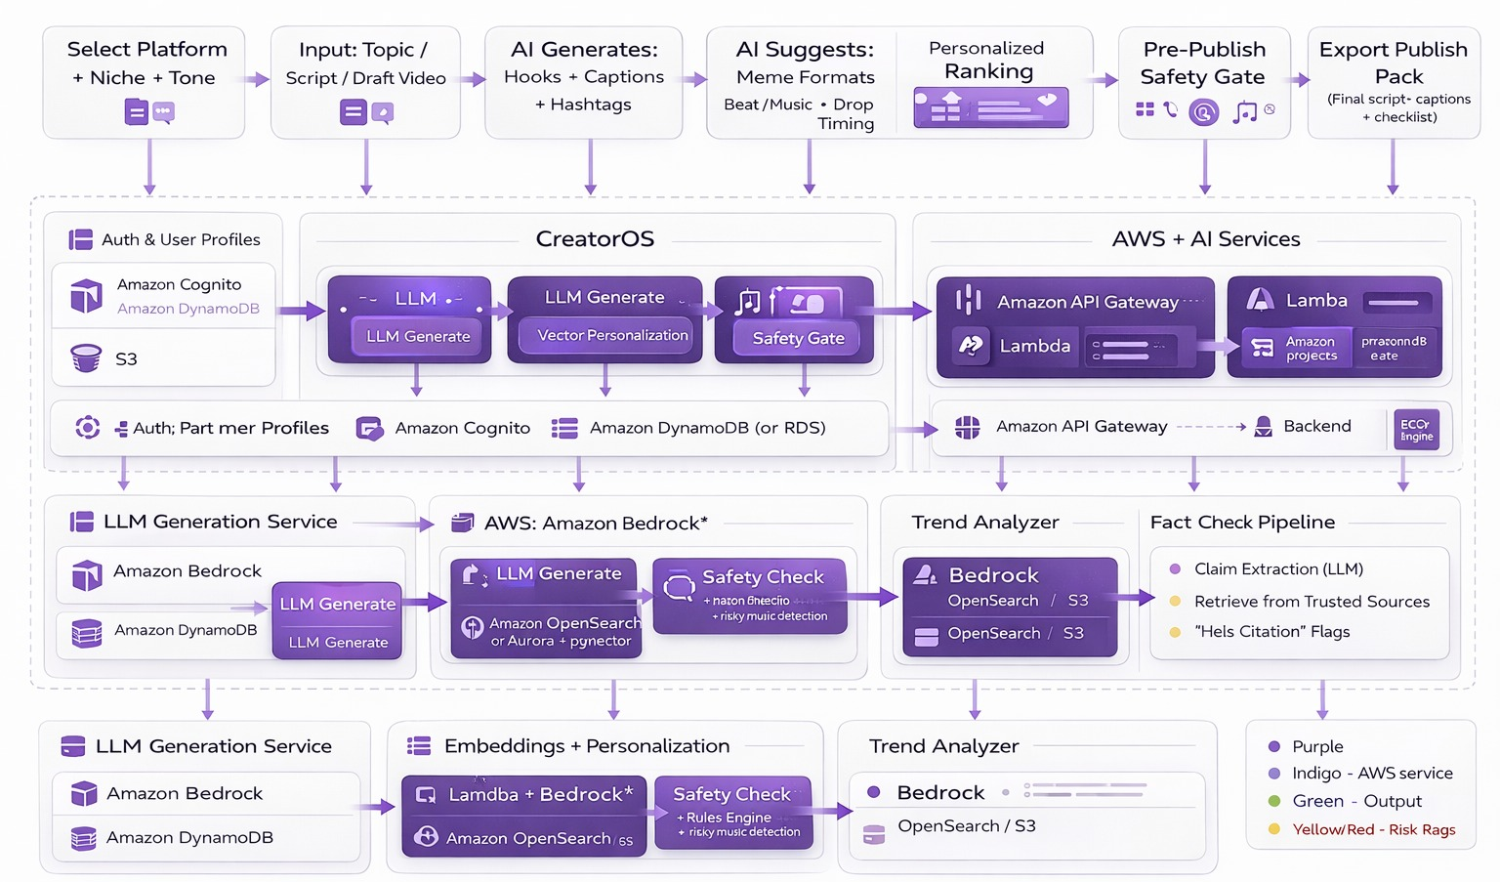
Process flow diagram or Use-case diagram

Slide 6
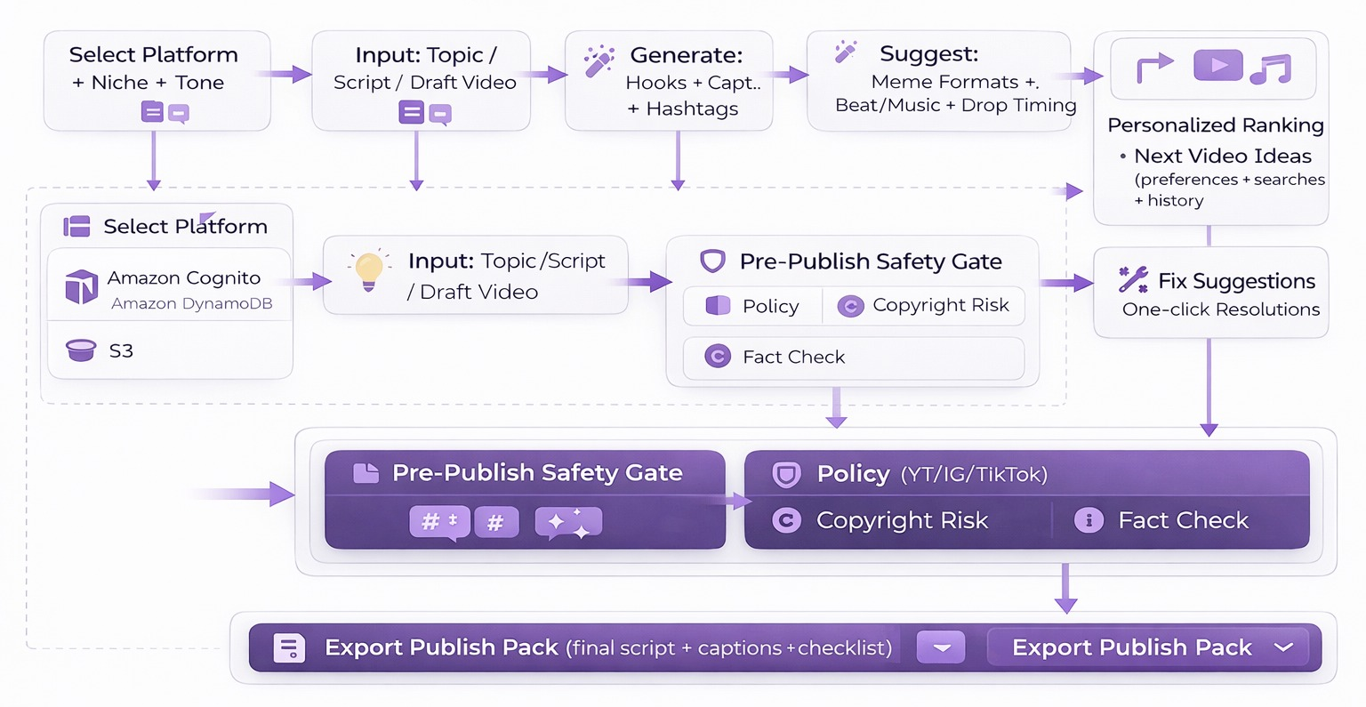
Wireframes/Mock diagrams of the proposed solution

Slide 7
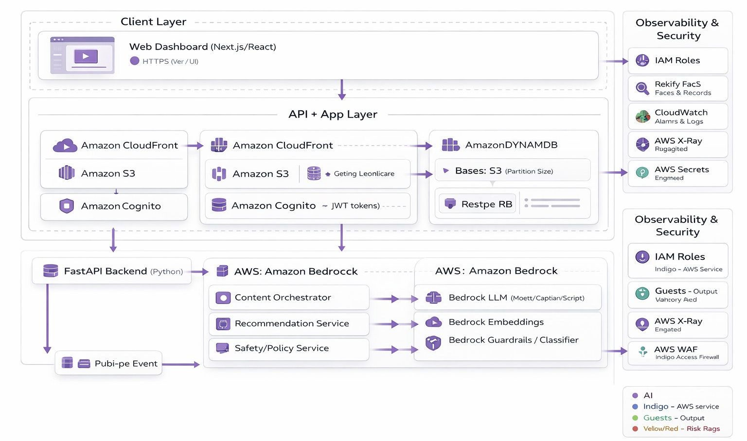
AI - AWS Architecture Diagram

Slide 8
Technologies to be used in the solution:
Frontend / Backend
Next.js + React (Dashboard)
Tailwind CSS (UI)
Python FastAPI (REST APIs)
Docker (containers)
AWS ECS Fargate (deploy)
AI / ML
Amazon Bedrock LLM (hooks/captions/scripts)
Bedrock Embeddings (content + user vectors)
Bedrock Guardrails / classifiers (risk scoring)
Personalization / Search
Amazon OpenSearch (Vector Search / ranking)
Aurora PostgreSQL + pgvector
Data Storage
Amazon RDS PostgreSQL (users/projects/reports)
Amazon S3 (uploads + exports)
DynamoDB (optional preferences/sessions)
Workflow / Media Pipeline
AWS Step Functions (pipeline orchestration)
AWS Lambda (S3 triggers/processing)
Security / Monitoring
Amazon Cognito (JWT auth)
AWS IAM (roles/policies)
Amazon CloudWatch (logs/metrics/alarms)
AWS X-Ray (optional tracing)

Slide 9
Estimated implementation cost (optional):
MVP (Hackathon Prototype: 2–7 days)
Hosting: AWS Free Tier / low usage (CloudFront + S3 + API Gateway + Lambda/ECS)
Storage: S3 (small video uploads + exports)
Database: RDS (free tier/low instance) or serverless alternative
AI usage: Limited Bedrock calls with caching (hooks/captions, embeddings, safety checks)
Estimated cost: ₹0 – ₹3,000 (mostly depends on AI calls + storage)
Pilot (1–3 months, small creator group)
More consistent usage of Bedrock + OpenSearch vector search
Larger S3 storage + Step Functions media pipeline
Estimated cost: ₹10,000 – ₹50,000 / month (depends on active users, minutes of video processed, AI calls)
what affects cost most
Number of LLM generations per user/day
Speech-to-text minutes (Transcribe/ASR)
Vector DB size + query volume (OpenSearch)
Video storage + bandwidth (S3 + CloudFront)

Slide 10
Add as per the requirements for the hackathon:
Problem Fit
AI for Media, Content & Digital Experiences
One workflow: Create → Optimize → Personalize → Publish Safely
Supports: content creation, transformation, tagging/discovery, distribution readiness
Tech & AWS Integration
Frontend: Next.js + React
Backend: FastAPI on ECS Fargate + API Gateway
AI: Amazon Bedrock (LLM + embeddings + safety classifiers)
Data: S3 (uploads/exports), RDS Postgres, OpenSearch (Vector DB)
Pipeline: Lambda + Step Functions (+ optional Transcribe)
Ops/Security: Cognito, IAM, CloudWatch
Impact
Cuts content production time hours → minutes
Improves retention via hook + pacing + trend-format upgrades
Reduces strikes/takedowns using policy + copyright + fact checks
Helps creators grow with preference-based recommendations (not just trending)
Future Scope
Auto edit suggestions with timestamps (cuts, highlights)
A/B testing for hooks/captions + performance learning loop
Multi-brand/team approvals dashboard
Multilingual localization (Hindi + regional languages)

Slide 11


